Slide 1
Guidance for Adults Delivering the Award: Helping Participants Design Their AJ
The purpose of this document is to guide Award Leaders on how to help their participants design their Adventurous Journey through the model:
Brainstorm Plan Do Review
The included resources help structure a well-prepared approach, which is essential for a successful and safe journey. Choose the resources and delivery methods that best suit your Award Centre's needs.
Table of Contents
Slide 2-5: Overview | Slide 20-23: Completing the Journey
Slide 6-10: Brainstorming Adventurous Journeys | Slide 24-26: Reviewing the Journey
Slide 11-19: Planning for the Adventurous Journey | Slide 27-31: Example & Extra Resources

Slide 2
Overview – Adventurous Journey
Brainstorm:
Start collaboration to gather ideas and decide on an Adventurous Journey.
Plan:
Build out the necessary elements of the journey to ensure participants are well prepared.
Journey:
Embark on a safe, fun Adventurous Journey!
Review:
Reflect on the experience as a group and complete the debriefing report.

Slide 3
Overview – Adventurous Journey
AJ team size should be between 4-8 young people. The minimum time requirements are as follows:
Practice Journey:
Bronze: 1 day, 6hrs of Purposeful Activity
Silver: 1 day, 1 night, 7hrs of Purposeful Activity/day
Gold: 1 day, 1 night, 8hrs of Purposeful Activity/day
Qualifying Journey:
Bronze: 2 days, 1 night, 6hrs of Purposeful Activity/day
Silver: 3 days, 2 nights, 7hrs of Purposeful Activity/day
Gold: 4 days, 3 nights, 8hrs of Purposeful Activity/day
*Purposeful activity refers to the time spent journeying and working toward the team goal, it doesn’t include leisure and sleep time.

Slide 4
Overview – Considerations
Before participants begin brainstorming ideas for their Adventurous Journey, Award Leaders may want to provide some parameters based on the resources and experience your Award Centre has.
Review Adventurous Journey Requirements to understand the parameters and Overview of Adventurous Journey Options to see what types of AJ’s are available.
Consider available resources, funds and equipment your Award Centre has that may impact location, type of journey, mode of travel, accommodation and activities.
Provide examples of what other participants have done in the past.
Ensure you have established risk management and emergency procedures.

Slide 5
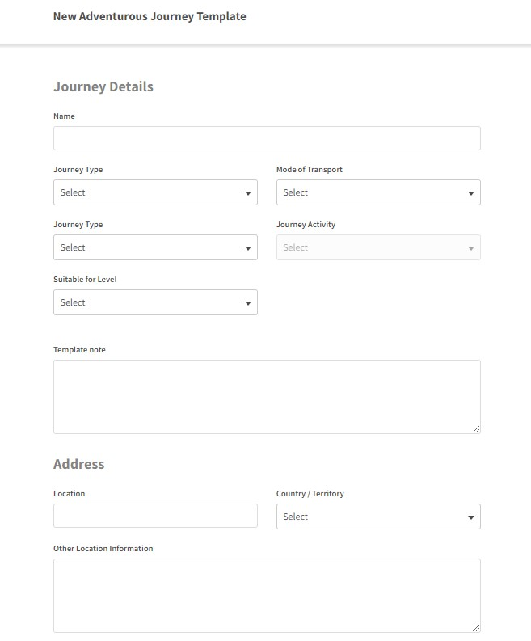
Overview – Online Record Book
On the ORB, the two options for selecting journey type are practical and virtual:
On the ORB, Award Leaders can set up AJ templates and assign participants. This can be done by navigating to the “Adventurous Journey” tab and then clicking on “Adventurous Journey Templates”.

Slide 6
Brainstorm Plan Journey Review

Slide 7
Brainstorm - Overview
Brainstorm: In this section, the objective is to help your participants brainstorm ideas and design their AJ. By the end of this section, participants should have:
Brainstormed realistic AJ options.
Chosen a realistic AJ.
Worked with their Award Leader to review their idea and receive approval.
Thought of budget/funding for the journey.
Know who is attending.
Decided on a general location.
Decided on timing/duration.
Chosen activity and mode of travel.

Slide 8
Brainstorm – Techniques
Below are some great ways for participants to get ideas flowing:
Nominal Group Technique: Participants silently write down their ideas, which are then shared without discussion. Participants then discuss and anonymously rank the ideas to identify the most promising ones. (Great to get ideas flowing when participants may be afraid to speak up).
Round-Robin Brainstorming: In a circle, each participant takes turns sharing one idea. Keep going around the circle until everyone has had a chance to contribute (may want to allow for individual idea building before starting).
Idea Cards: Create a set of cards, each with a different prompt. Participants can draw a card and discuss or develop ideas based on what's on the card.
Utilize Online Platforms to do remote group brainstorming such as Google Docs and whiteboards.

Slide 9
Brainstorm – Research
Relevant in Your Region: Start learning more about what is available in their region by googling activities, resources and locations in your area.
Local Tourism Websites: Visit the official tourism website of their city or region. These websites often provide information about outdoor activities and attractions in the area.
Local Guidebooks and Maps: Look for local guidebooks, maps and trail guides.
Outdoor Forums and Groups: Participants can join online forums or groups about the outdoors in their region. Websites like Reddit or Facebook can be great places to find recommendations.

Slide 10
Brainstorm – Research
Use Outdoor and National Park Apps and Websites: Websites such as AllTrails allow you to search for trails and outdoor activities based on your location. National Park websites provide information on trails, camping and outdoor activities.
Ask Experienced People for Their ideas: Parents, other leaders, outdoor educators, subject matter experts etc.
Look at past or example journeys: See AJ Library for more examples.
Experiment and Explore: Sometimes the best way to find outdoor journey ideas is to simply go out and explore. Take day trips to nearby parks, lakes, rivers and forests.

Slide 11
Brainstorm Plan Journey Review

Slide 12
Plan – Overview
Plan: In this section, the objective is to help your participants properly plan out the logistics of their AJ. By the end of this section, participants should have:
Decided on a team goal, location and dates.
Planned out resources, equipment, supplies and materials (i.e. route, permits, maps, food, cooking equipment, accommodations) etc. May want to use the AJ Planning Guide.
Identified proper skills, training and safety plans needed.
Know who the Assessor/Supervisor(s) for the journey is.
Received approval for their AJ plan from the adults involved in delivering the Award involved.

Slide 13
Plan - Goal Setting
The team must set a clear and challenging goal that is achievable and defines what activities the team will be doing. ​The Assessor provides assessment based on whether the team meets their goal.​
Adventurous Journey Team Goals should include: ​
A description of the environment and destination of the adventure.​
What activities will be done and how they will journey.​
What the team hopes to accomplish.
*Use the AJ Team Goal Builder with participants for support.

Slide 14
Plan – Emergency Procedures
We believe that all incidents are preventable. However, all activities have intrinsic risk, and it is critical that procedures are followed on these occasions to safeguard the interests of all involved.
Your organization MUST:
Have emergency procedures and policies in place to deal with any incidents that may occur as a result of Award activities. These procedures will be in line with the wider emergency protocols and policies of your organization. All adults involved in Award delivery must be aware of these procedures.
Ensure parents and guardians of those under the age of majority are informed that it is their responsibility to ensure all activities are properly managed and insured where appropriate.
Report to the Award Office any serious incident or accident that leads to or could have led to the serious injury of a participant or any adult involved in the delivery of the Award.

Slide 15
Plan – Emergency Procedures
All aspects of planning the Adventurous Journey including routes, gear, campsites, weather, and activity should be assessed and documented to identify potential hazards and risks involved.
All risk assessments should be maintained and updated if any aspect changes (e.g. season, weather, group size, mode of travel, scope of activity etc.).
Risk assessments should be reviewed prior to every trip, even if it is in a familiar environment, especially if the participants are different.

Slide 16
Plan – Emergency Communication
Emergency contacts and communication plans MUST be established before starting a journey. Depending on the type of journey being taken, different communication plans will be needed. For example, a back-country trip may need more extreme emergency communication and exit plans based on remote access to emergency services. Plan accordingly with your participants to ensure safety plans are in place. Everyone involved should know what to do in an emergency situation and who to contact. Emergency methods to consider include:
Cell phones - Bring reliable communication devices such as a charged cell phone or two-way radio. Familiarize yourself with their operation and range.
Sharing plans & location - Ensure your plans are known to the Award Centre, parents/guardians, emergency contacts, park rangers etc.
Trackers - Some trackers offer GPS, two-way communication, emergency signaling, and location tracking.
Satellite phones – Satellite phones utilize satellites to make calls in areas where cellular service is absent.
Signaling devices – Consider utilizing whistles, mirrors (reflective signals), flashlights with batteries, flares etc.

Slide 17
Plan – Risk Management
Based on the type of Adventurous Journey, location and mode of travel/activity being done additional certifications or training may be required by the adults involved and/or provider to ensure safety. Ensuring participants undergo necessary training to be competent in safe travel practices and safety measures throughout their journey is vital. Examples of specific training certifications may include Standard First Aid, National Lifeguarding, White Water Certification, Wilderness Advanced First Aid, Wilderness First Responder etc.
Wildlife encounters – Research wildlife you may encounter on your journey, respecting their space and understanding best practices if a close encounter happens.
First Aid - Carry a well-equipped first aid kit suitable for the AJ’s activities and duration.
Knowledge and skills – Ensure the group is competent on navigation, caring for basic group needs such as shelter, food, water and basic first aid skills. The AJ Supervisor must be suitably qualified, competent and experienced to ensure the group remains safe.
Stay in groups – Always remember to stay in groups and be aware of your surroundings and people within your group.
Be prepared and informed - Research the area and forecast of the location you'll be exploring.
Pack for unexpected situations – Bring extra items in case things get lost, broken or don’t go according to plan. Pack for changing weather i.e. rain gear, warm layers etc. Bring extra food.

Slide 18
Plan – Risk Management
Discuss potential risks or hazards the group could encounter while on the trip so contingency plans can be made. Creating scenario-based questions to challenge participants while they are brainstorming ideas for their Adventurous Journeys is a great way to get them thinking about what to do in unexpected situations.
Example questions to ask how an AJ team will handle these situations:
What will you do if someone gets an injury?
What will you do if someone gets lost?
What will you do if there is a missing trail marker, how will you stay on track?
What will you do if gear/equipment breaks or is damaged?
What will you do if you have unexpected bad weather? What if the forecast is predicting terrible weather throughout the journey?

Slide 19
Plan - Budgeting
Here are some strategies to help outline a budget for your AJ:
Budget Expense Categories: Transportation, accommodation, food, gear, permits, etc. This will help you allocate funds appropriately.
Explore Accessible Options: Doing an AJ that is locally accessible, using public transportation, utilizing back yards or organizational spaces (i.e., gyms and fields) for overnight stays.
Digital Tools/Apps: Use tools like Microsoft Excel or Google Sheets to create a customized budget spreadsheet. May also consider using a budgeting app such as Mint.
Apply for Grants/Funding: Research grants/funding available that could be used for Adventurous Journeys. Apply for Award grants and funding that can cover Award Centre AJ costs.

Slide 20
Brainstorm Plan Journey Review

Slide 21
Journey - Overview
Journey: In this section, the objective is to ensure your participants embark on their fun, safe AJ. By the end of this section, participants should have:
Carried out the planned Practice Journey (PJ) and Qualifying Journey (QJ).
Followed the steps and guidelines they outlined during the planning phase.
Reflected on each day of the journey and taken notes to make the review section easier.

Slide 22
Journey
Ensure the review of the PJ is built into the plans and approved by the Supervisor/Assessor before starting the QJ.
After the PJ has been reviewed, adjust the QJ if needed and send to your Supervisor/Assessor for review.
Follow plans and guidelines that were decided on for the journey during the planning phase.
Debrief as a group and take notes in a journal/logbook each day of the Journey to make the review section easier.
Overcome obstacles as a team and have fun!

Slide 23
Journey - Supervision
All journeys must be supervised by a suitably qualified, competent, and experienced Adventurous Journey Supervisor.
The Supervisor must have expertise (or qualification, as per the province’s legislation) in the mode of journey being used and familiarity in the terrain, and location that the journey is taking place.
The Adventurous Journey Supervisor is responsible for the group’s safety while on the journey, needs to be familiar with the Award and must be satisfied that all group members are properly trained, suitably competent and equipped to undertake the Adventurous Journey.

Slide 24
Brainstorm Plan Journey Review

Slide 25
Review - Overview
Review: In this section, the objective is to debrief the Adventurous Journey. Participants will reflect on their experience to assess what they’ve learnt and what they have achieved. By the end of this section, participants should have:
Evaluated and reflected on what has been done and accomplished.
Assessed whether they achieved their goals.
Discuss what could be done differently next time.
Completed and submitted a group debriefing report (if required by the Award Leader).

Slide 26
Review
Evaluate and reflect on what you have accomplished.
Assess whether you achieved your goals and if the process went as planned.
Discuss what could be done differently next time.
Complete a team debrief and submit a report or presentation if required by the Award Leader.
Submit an AJ Group Assessor Report on the ORB for the Practice and Qualifying Journey.

Slide 27
Example & Extra Resources

Slide 28
Example
Here is an example AJ that has that we will incorporate into the Brainstorm, Plan, Journey and Review model.
Adventurous Journey Example:
An urban AJ trip in Québec learning the history of the area and how it's shaped the culture. The plan is to do a walking route around Québec City that explores historical monuments and sites, taking photos and learning along the way. Travelling using public transportation and foot, to learn about Quebec city’s history and culture and camping in school gymnasium overnight. At the end of the journey a presentation will be delivered detailing what we learnt about the region's history and culture.

Slide 29
Example
Brainstorm
Brainstorm AJ ideas → A walking route.
Choose your AJ → an urban AJ in Québec learning the history of the area.
Who is attending → 4 participants, 1 AJ Supervisor.
Location → Québec City.
Duration → 2 days, 1 night, 6 hours of Purposeful Activity each day.
Mode of Travel → Walking.
Assess if the AJ is doable and realistic → Are there enough landmarks in Québec City within proximity? Can you realistically walk to and from all of them?
Has your Award Leader given approval? → Yes.
Plan
Research → locations, historical landmarks and cultural attractions in Québec City.
Create a detailed plan and route → Use the planning guide and google maps.
Review → plans, risk management and emergency procedures.
Plan mode of transport → Public transportation and walking.
Gather any required equipment → Food, water, mattresses, sleeping bags, personal gear etc.
Decide on the methods to collect information → Notes, photos, recording audio and video.
Create a Team Goal → Focused on exploring Québec City's historical and cultural heritage and building a presentation for fellow classmates.

Slide 30
Example
Journey
Carry out the planned AJ.
Follow your plan to visit historical sites (Old Québec & Place Royale).
Take notes, photos and record audio/video as you explore.
Gather information about the historical significance of each site and the cultural influences.
Review
Organize the information you've collected during your trip → What your team learnt about the region's history and culture.
Identify historical and cultural elements that have shaped Québec City.
Create your presentation.
Reflect on your trip and what you've learned.
Complete the group debriefing report and upload to the ORB.

Slide 31
Extra Resources
You can visit our AJ Navigator which includes more information, guides, templates and manuals for Award Centres to use to assist with all aspects of helping participants plan and complete their Adventurous Journey.
If you have any questions regarding delivering the AJ, reach out to your Account Manager or the Support Centre.
Notes:
Link navigator instead of delivery resource portal.*****

Slide 32
GENERAL CONTACT DETAILS
858A King Street West Toronto, ON M5V 1P1 Phone: (437) 747-0449 Email: support@dukeofed.org
Monday – Friday 10:00 am – 6:00 pm ET Charitable Registration Number: 12391 6751 RR0002
www.dukeofed.org
FOLLOW US ON SOCIAL MEDIA!
@dukeofedcanada
@dukeofedcanada
@dukeofedcanada
www.linkedin.com/company/dukeofedcanada

